Slide 1
5 BRANDS UNDER ONE ROOF

Slide 2
COMPANY OVERVIEW Scope Imports Sierra Pacific Burnside FeatherLite Hilton Retro Bowling Speed Zone
Scope Imports was founded in 1966. At the time Scope was one of a few companies that imported from Asia, before Importing from Asia became the standard. Scope’s primary business was traditionally, classification importing until the company started to focus more in the branded space in the mid-90s.
Sierra Pacific founded in 2000, utilized the Import strength of Scope and entered the market doing private labels for Bodek and Rhodes. Sierra Pacific took key private label items like Polar Fleece, twills, and began offering them to wholesalers who do not run their own private label.
Burnside was founded in 1996 and was brought into the promotional industry in 2014. Burnside was introduced to produce value lifestyle fashion apparel to the promo world, to build on its many years of Retail success.

Slide 3
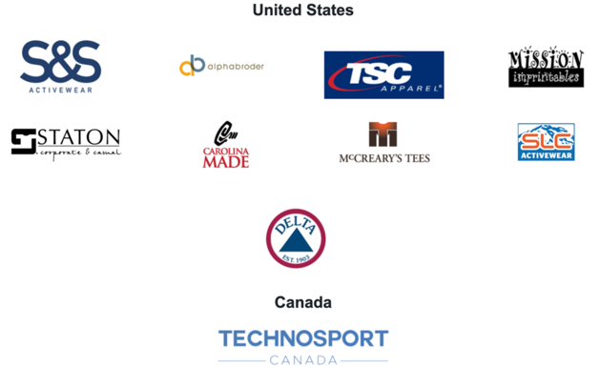
PAUL KORY VP OF BUSINESS DEVELOPMENT 678-332-7932 paul@sierrapacificapparel.com
Scope Imports was founded in 1966. At the time Scope was one of a few companies that imported from Asia, before Importing from Asia became the standard. Scope’s primary business was traditionally, classification importing until the company started to focus more in the branded space in the mid-90s.
Sierra Pacific founded in 2000, utilized the Import strength of Scope and entered the market doing private labels for Bodek and Rhodes. Sierra Pacific took key private label items like Polar Fleece, twills, and began offering them to wholesalers who do not run their own private label.
Burnside was founded in 1996 and was brought into the promotional industry in 2014. Burnside was introduced to produce value lifestyle fashion apparel to the promo world, to build on its many years of Retail success.

Slide 4
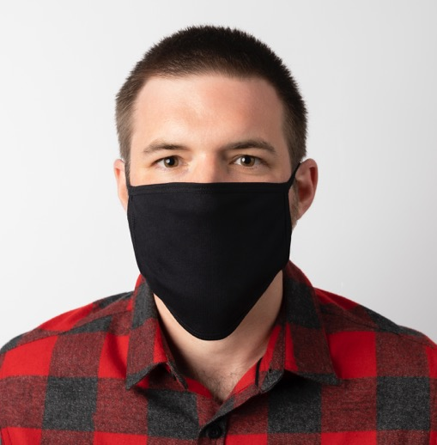
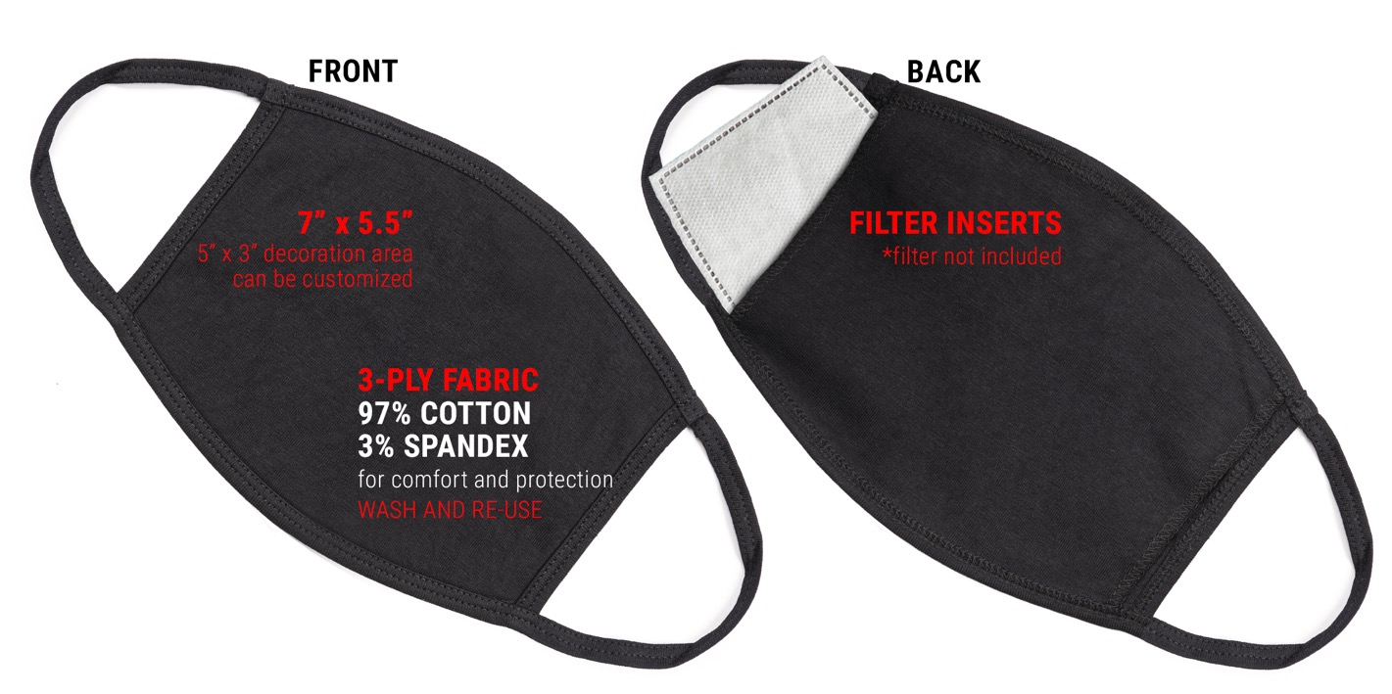
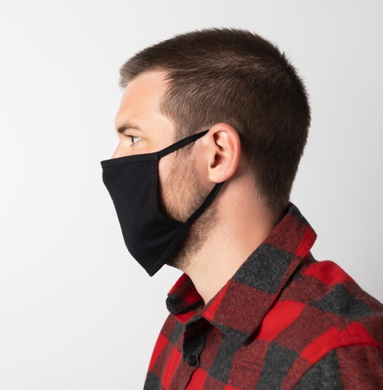
FACE MASKS
P100 Face Masks
97/3 cotton spandex
3-Ply Fabric
7”x5.5” cover area
5”x3” decoration area

Slide 5
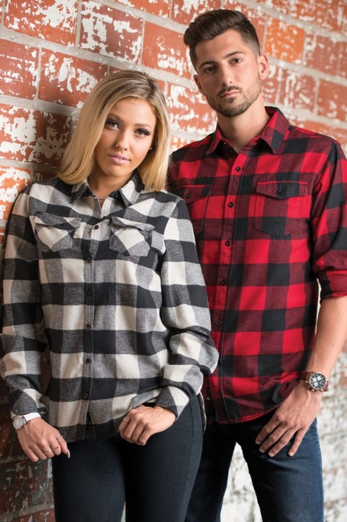
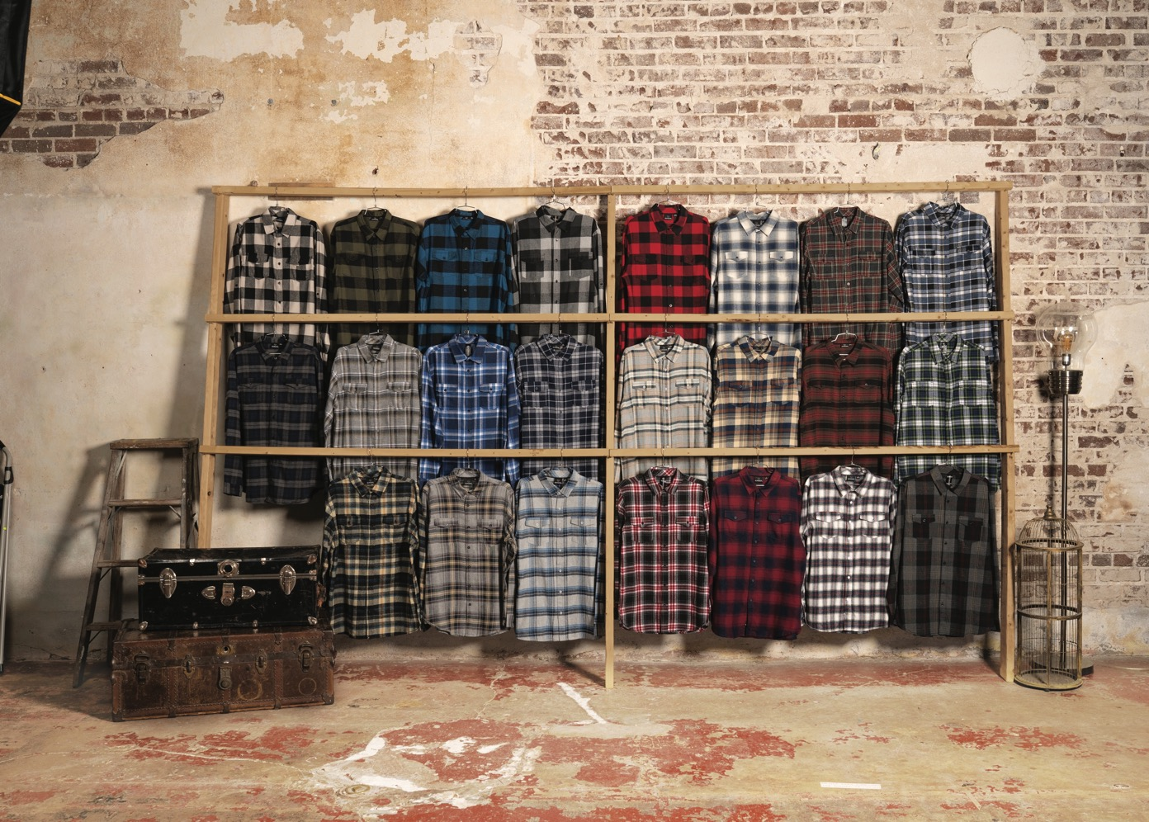
PLAID FLANNELS
Black/grey
Ecru black
Red/black
Khaki
Red
White/red
Grey/blue
Blue/white
Navy/grey
Light grey
Crimson
Grey/olive
Navy
Crimson/navy
Black/steel
Stone
Blue
Brown
Ecru/blue
THE MOST FLANNEL PATTERNS IN
THE INDUSTRY
B8210/B5210 PLAID FLANNEL
5.4 oz. 80/20 cotton/poly
2 chest pockets
Button pocket flaps
Half back yoke
Hem bottom
Button cuffs
B5210: Elongated drop tail
B8210: Roll up sleeves placket
Modern fit
Sizes: S-3XL
21 colors

Slide 6
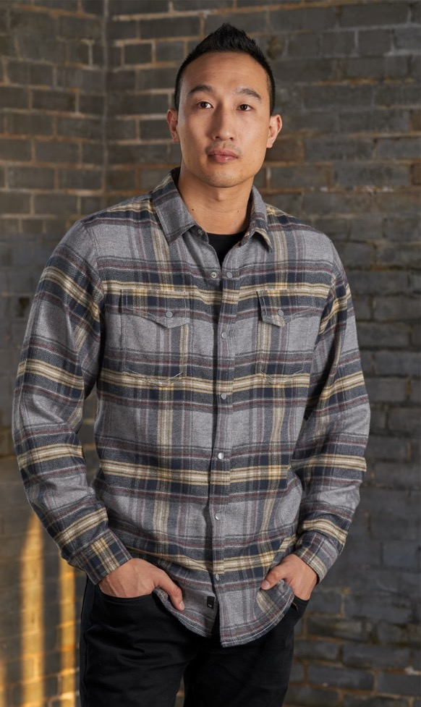
SOLID & SNAP FLANNEL
B8200/5200 SOLID FLANNEL
5.4 oz. 80/20 cotton/poly
2 chest pockets with button flaps
Button cuffs
Hem bottom
Half back yoke
Locker loop
Modern fit
Sizes: S-3XL
4 colors
B8219 SNAP FLANNEL
5.4 oz. 80/20 cotton/poly
2 chest pockets with snaps
Dyed to match snaps
Inside chest pocket
Snap cuffs
Half back yoke
Modern fit
Sizes: S-3XL
3 colors

Slide 7
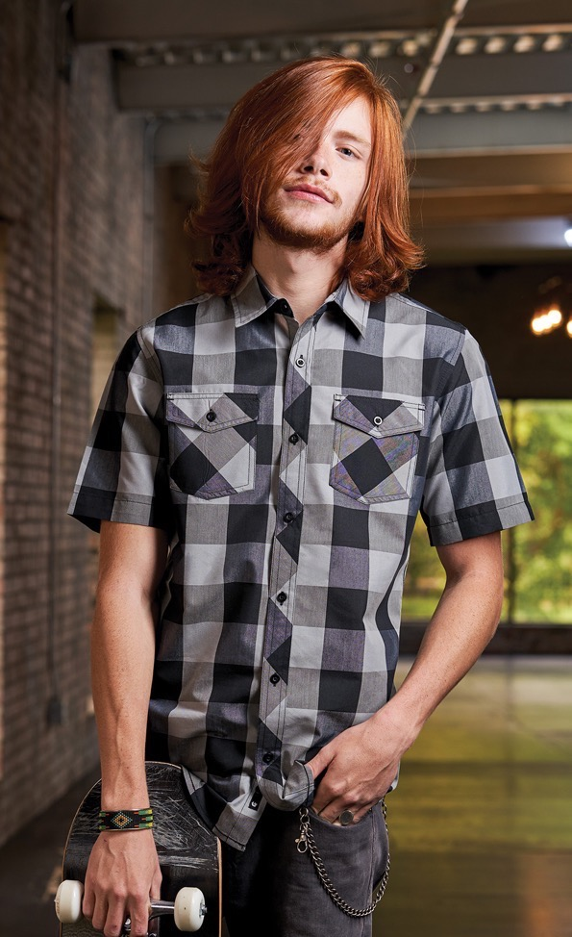
PLAID WOVENS
PLAID WOVENS
B9202 men's short sleeve
B8202 men's long sleeve
B5222 ladies long sleeve
3.0 oz. 55/45 cotton/poly
2 chest pockets, button flaps
2 piece back yoke
Pearlized buttons
Modern fit
8202: Adjustable button cuffs
5222: Roll up sleeve placket
Men's Sizes: S-4XL
Ladies Sizes: S-3XL
B9203 BUFFALO PLAID
2.8 oz. 55/45 cotton/polyester
2 chest pockets with button flaps
Hem sleeves
Chain stitched bottom hem
Modern fit
Sizes: S-3XL
4 Colors

Slide 8
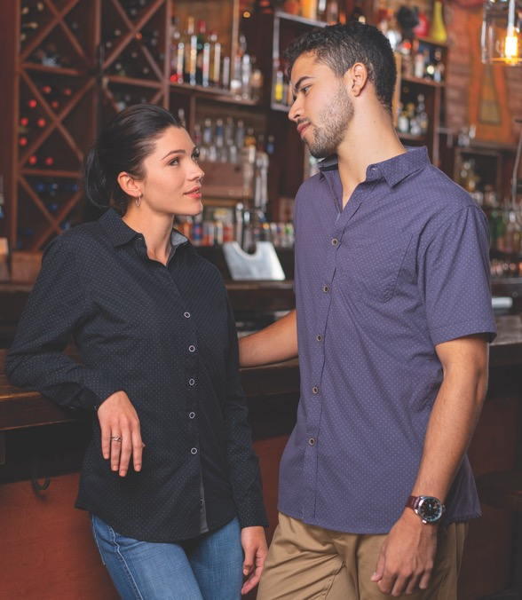
WOVENS, CHAMBRAYS, AND PEACHED POPLINS
B5290
B9290
B9255 CHAMBRAY
B9255 Short Sleeve
B8255 Long Sleeve
B5255 Ladies Long Sleeve
4.0 oz. 80/20 cotton/poly
2 chest pockets, button flaps
2-piece western back yoke
Inverted back pleat
Button cuffs
Modern fit
Sizes: S-3XL
2 Colors
MENS B9290, B8290
LADIES B5290
100% cotton
Chambray lined collar & cuff
Left chest button pocket
B5290 has no pockets
Chain-stitched bottom hem
Half back yoke
Black neck taping
B5247: Roll-up sleeve placket
Modern Fit
Sizes: S-3XL
4 colors
TEXTURE WOVENS
MENS B9247
LADIES B5247
B9247 mens
B5247 ladies
3.3 oz. 65/35 cotton/polyester
2 chest pockets, button flaps
Front stitching and on yoke
Hem sleeves and bottom
Blue & red have black inner collar
B5247: Roll-up sleeve placket
Modern fit
Sizes: S-3XL
3 Colors

Slide 9
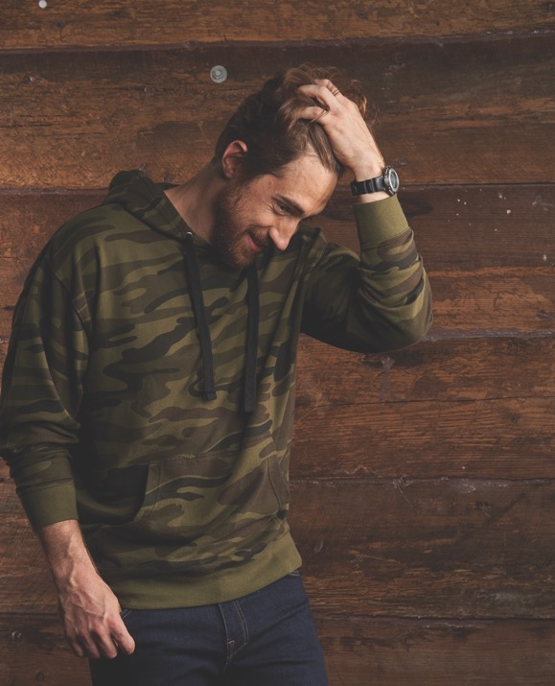
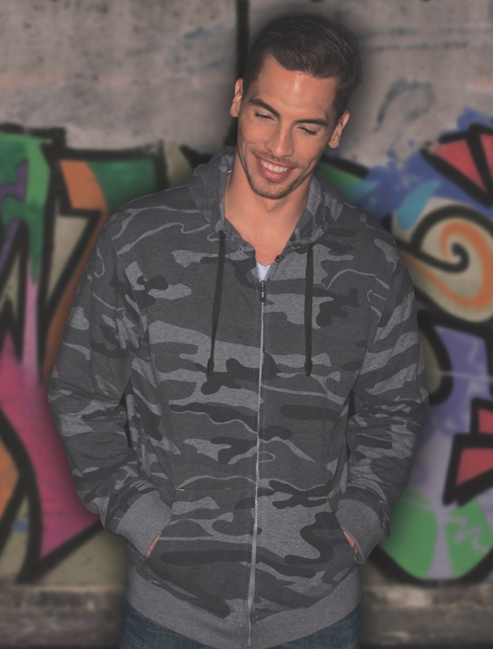
HOODIES
B8127 JERSEY RAGLAN HOODIE
4.9 oz. Heather colors
4.1 oz. Striated colors
Striped sleeves and hood
Front pouch pockets
Hem cuffs & bottom
Raglan sleeves
Sizes: S-3XL
3 colors
B8605 FRENCH TERRY ENZYME WASHED HOODIE
6.8 oz. fleece
Black 70/30 cotton/poly
Green 100% cotton
Enzyme washed
Decorator friendly
Black drawstring
Front pouch pocket
Rib bottom & cuffs
Sizes: S-3XL
2 colors: Black Camo, Green Camo
B8615 FRENCH TERRY ENZYME WASHED HOODIE
6.8 oz. fleece
70/30 cotton/poly
Green Camo 100% cotton
Enzyme washed
Decorator friendly
Black drawstring
Nylon zipper
Sizes: S-3XL
3 colors: Black, Green Camo, Black Camo

Slide 10
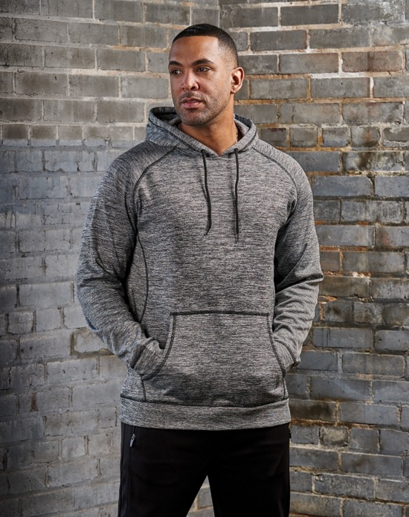
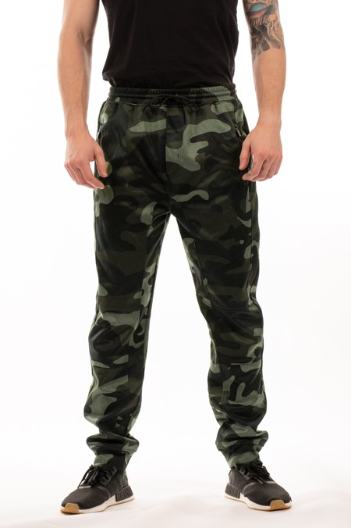
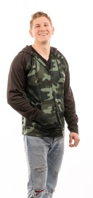
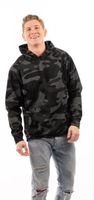
HOODIES & JOGGERS
B8670, B8660 HOODIES
6 oz. 100% polyester
Raglan sleeves
Front pouch pockets
Overlock stitching detail
Hem bottom & cuffs
Black draw cord
Sizes: S-3XL
4 colors
B8801 JOGGERS
6 oz. 100% poly
Elastic waistband
Black draw cord
Faux fly
Knee piping
Back pocket
Side zipper pockets
Hem cuffs
Sizes: S-3XL
4 colors
B8800 UNISEX JOGGER
7.8 oz. 100% Polyester fleece
Side pockets
Elastic waist and bottom cuff
Drawstring closure
Back right pocket
Sizes: S-3XL
5 colors
NAVY
BLACK
HEATHER
CHARCOAL
RED

Slide 11
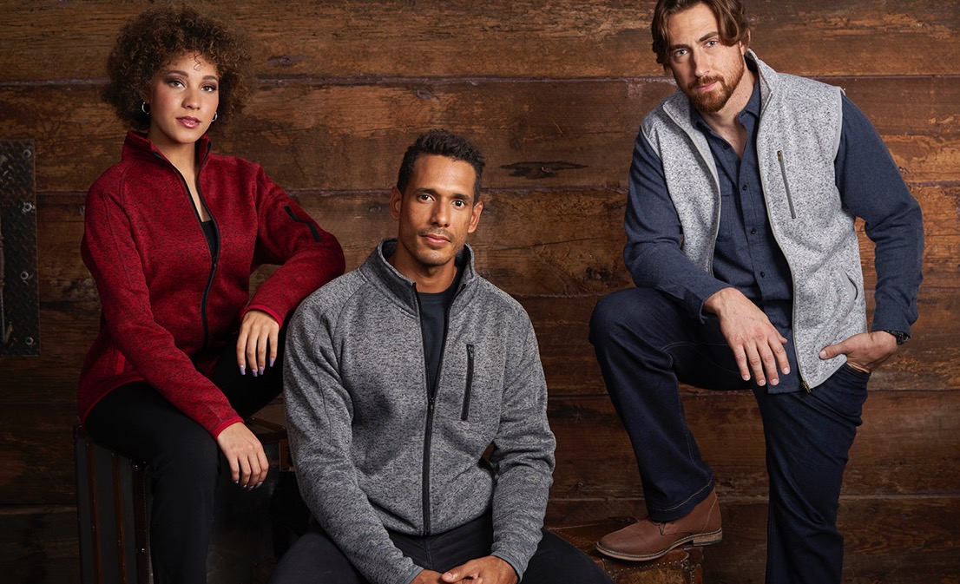
SWEATER KNITS
3901/5901/3910
6.5 oz.
100% poly fleece
Convertible collar
Full-zip with puller cover
Raglan sleeves for mobility
Metal Zipper Pullers
Piped cuffs and hem
Covered zipper side pockets
Adjustable button cuffs
Sizes: S-3XL
4 Colors
B5901
B3910
B3901

Slide 12
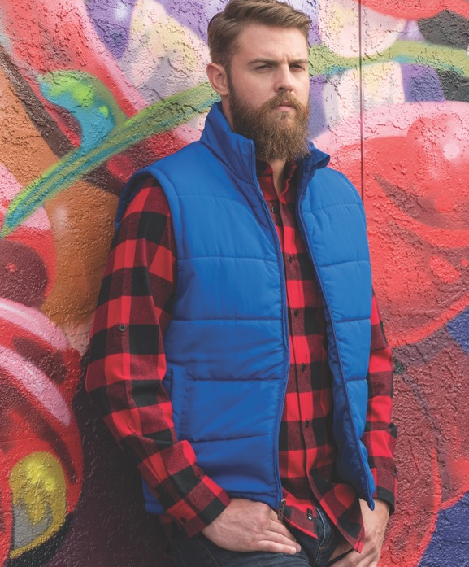
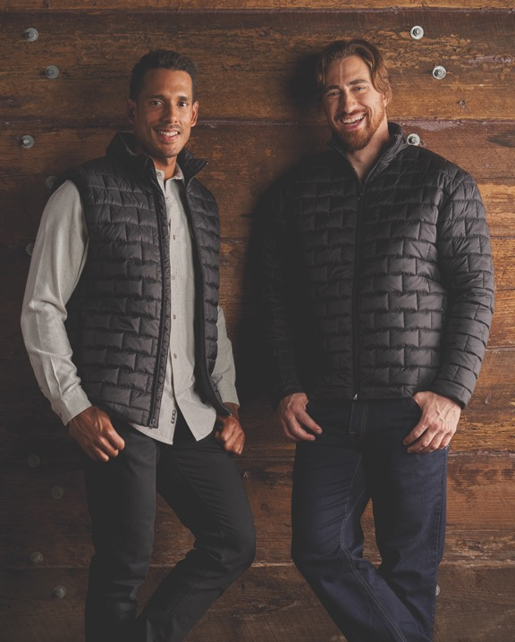
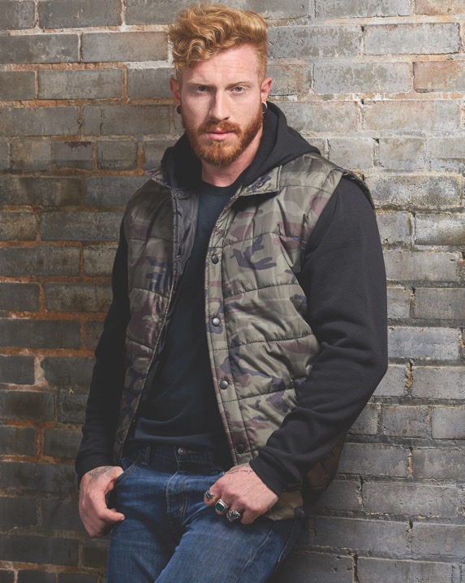
OUTERWEAR
B8700 PUFFER VEST
4.0 oz. 100% polyester
Heavy fill insulation
Barrel toggle waistband
Side entry pockets
Zipper pull cover on collar
Sizes S-3XL
5 colors
B8713/B8703 ELEMENT PUFFER
100% Nylon
Mini brick quilting
Side zipper pulls
Zipper cover at chin
Zipper cover on pockets
Inside zippered chest pockets
Sizes: S-3XL
3 colors
B8701 PUFFER VEST
8.5 oz. 100% poly shell
100% poly fleece insert sleeves
Snap front, 2 slash pockets
Rib bottom and cuffs
Camo interior lining
Black camo has solid rib cuffs
Sizes: S-3XL
4 colors

Slide 13
MOISTURE WICKING KNITS
S0100/S5100 POLO
3.8 oz, 100% polyester
Moisture wicking
Antimicrobial
Wrinkle resistant
Snag resistant
Rib knit collar
Pearlized buttons
Taped neck seam
3 button box placket
Hemmed sleeves
Square hemmed bottom
Side vents
Sizes: S-4XL
S0469-S5469 POLO
5.4 oz, 100% polyester
Moisture wicking
Taped neck seam
Pearlized buttons
Double needle stitching
Moon patch
Solid back
Box plackets
fashion knit collars
Side vents
Sizes: S-4XL

Slide 14
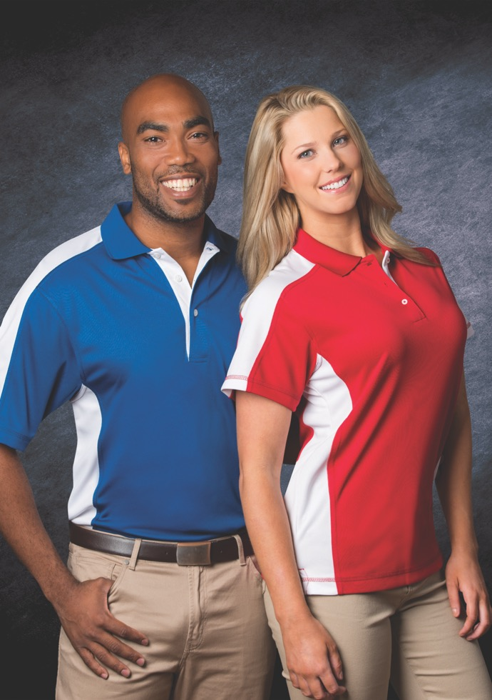
MOISTURE WICKING KNITS AND POLOS
S0500/S5500 SILKY SMOOTH KNITS
5.0 oz. 65% Polyester, 35% cotton
Soft hand pique knit shirt
Fashion knit collars
Taped neck seam
3 Button reinforced placket
Embossed metal buttons with dyed to match plastic rim
Welt sleeve cuffs
Side vents
Ladies has a feminine placket
Men Sizes: S-6XL
Lady Sizes: S-3XL
S0465-S5465 POLO
5.4 oz, 100% polyester
Moisture wicking
Contrast sleeves, body placket
Overlock stitching detailing
Taped neck seam
3 white pearlized buttons
Fashion knit collar
Double needle stitching
Side vents
Mens sizes S-4XL
Ladies S-3XL
8 colors

Slide 15
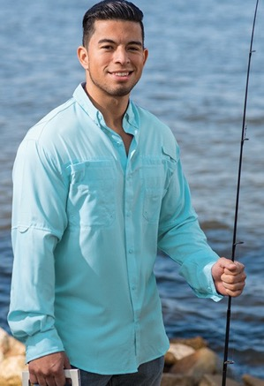
HILTON BOWLING & BAJA FISHING
HP2244 GM LEGEND
4.5 oz. 60% cotton/40% polyester
Light weight soft hand twill
Contrast notched self collar
Square cut bottom hem
Contrast body gussets & collar
Contrasting buttons
Piped trim pockets & sleeves
Sizes: XS, S-3XL
HP2243 CRUISER
4.4 oz. 60% cotton/40% poly
Light weight soft hand twill
Black collar & back
Black side body panels
Notched self collar
Contrasting hem sleeves
Contrasting buttons
Left chest pocket
Hemmed sleeve
Square cut bottom
Sizes: XS-3XL
ZP2297 SHORT SLEEVE FISHING SHIRT
ZP2299 LONG SLEEVE FISHING SHIRT
2.2 oz. 100% polyester ripstop fabric
UPF 40+ sun protection
Anti-microbial treatment
Mesh-lined half back with vertical vent openings
Two extra large chest box pockets
Moisture free technology pulls moisture away from the skin
Lower cargo style pockets with eyelets
Long sleeve has roll up sleeves with loop closure
Sizes: S-3XL

