Slide 1
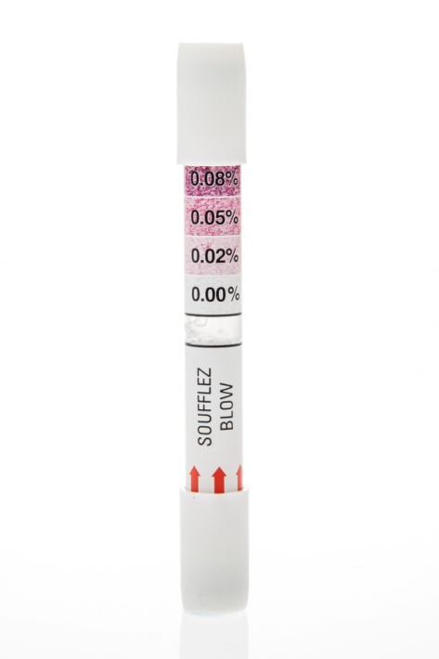
Blow before you go…Make sure your customers are ok to drive…
Proud partner of

Slide 2
Presentation
Who we are
Unique promotional product: single use breathalyzer
How it works
Benefits
Success stories
Questions

Slide 3
Who we are ?
31 years
All about safety
When you drink socially , what is your blood alcohol concentration ?
You have a speedometer in your car for speed limit
For alcohol you need a tool . You need a breathalyzer either single use or electronic

Slide 4
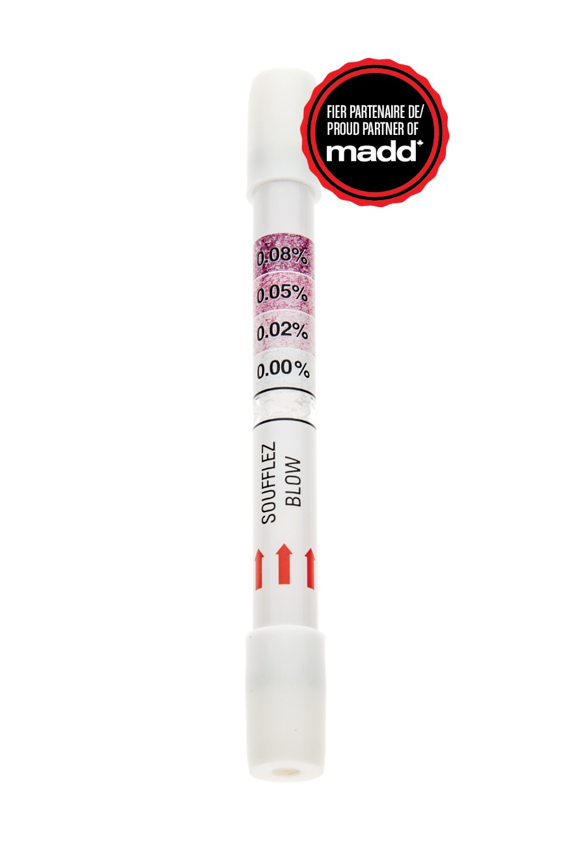
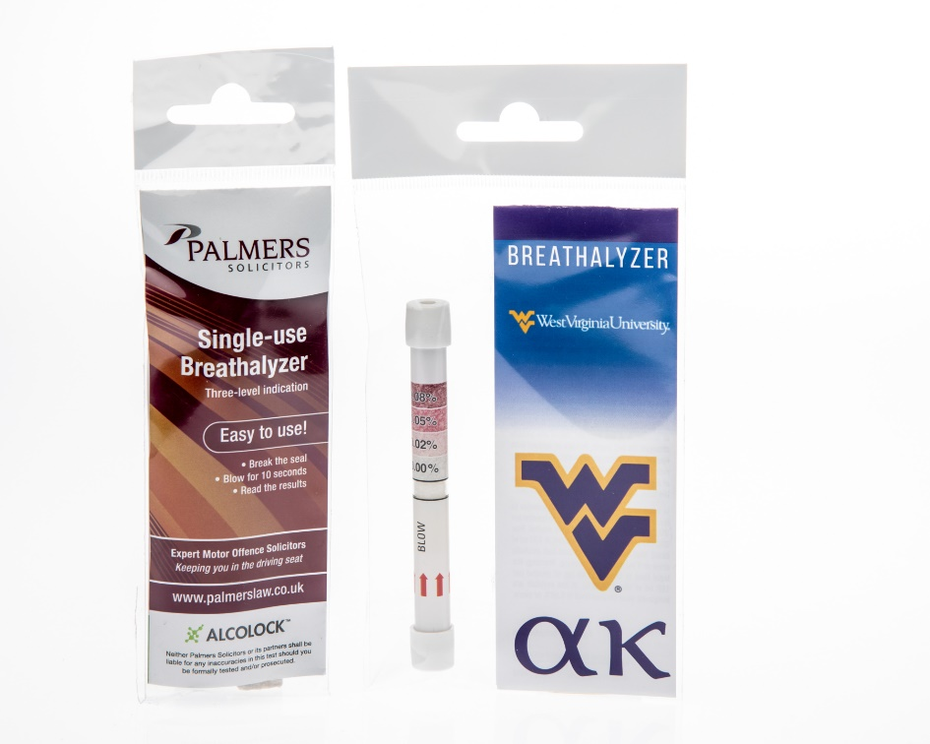

Slide 5
Why breathalyzers are a good idea…
Can you afford criminal record, fines, lose your job, family or kill someone ?
Many people lose their driving license every year…
Most of them were following social events.

Slide 6
Why breathalyzers ?
Excellent to convince a friend not to drive.
Endorsed by MADD as a good solution to prevent DUI.
Ethical and responsible.
Great corporate image.
They save lives.
67 % of consumers are looking for a breathalyzer.

Slide 7
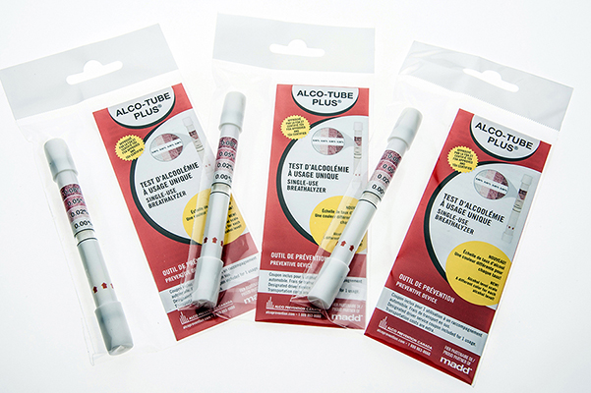
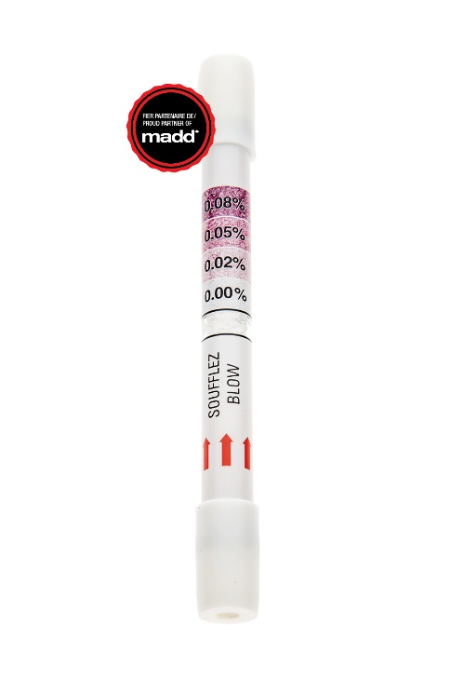
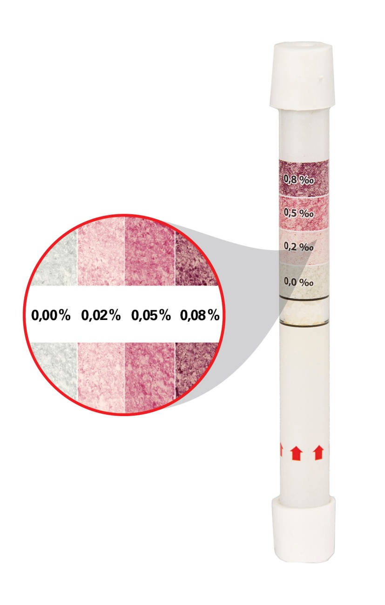
The single use breathalyzer
FDA Certified
Packaging with your logo
1-5-10 packs
On the same tester, it has a 0.02 and 0.05 and 0,08 line. There is a color to each BAC limit.

Slide 8
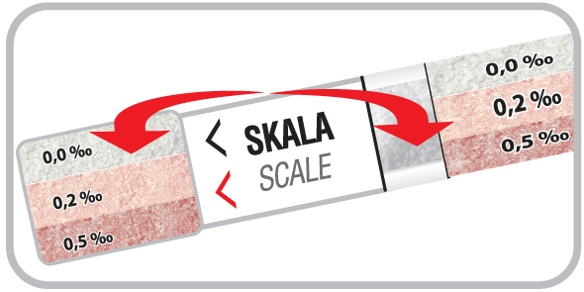
How to use it
Blow 10 seconds and see what colors are the crystals. Each color corresponds to 0.02 or 0.05 or 0.08
Push the two ends of the tube to break the security foil.

Slide 9
Success stories: Car dealers and manufacturers
Give away
When you buy a car.
Glove dept.
With a service(tire, oil change etc)
Gift when visiting a dealer

Slide 10
Events
Liability
X-mas
Golf
Promote road safety
Great corporate image

Slide 11
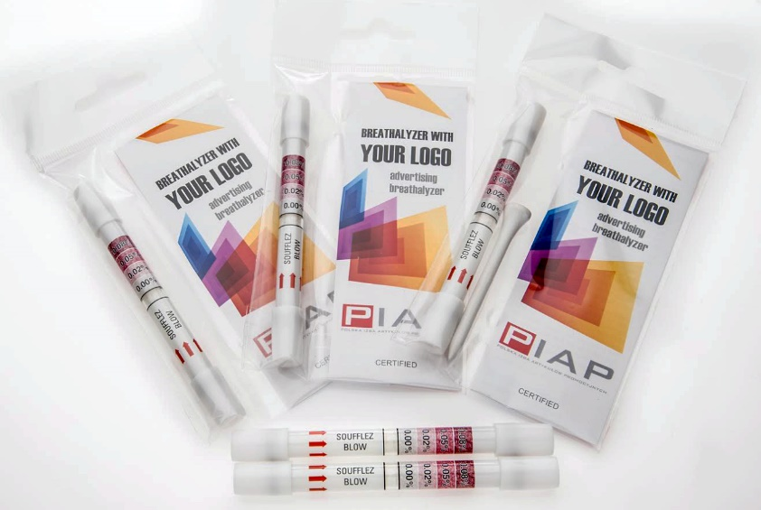
Golf: the alco tee !
A tee for the first hole and a breathalyzer for the 19th.. Hole
Something different than golf balls!
A good way to cover liability
Very innovative

Slide 12
Universities and colleges
As a welcome package beginning of the year
Sends a positive message

Slide 13
Wine, beer and food industry
Complementary to their business
Get a free breathalyzer with a bottle of wine
Sends the right message Drink responsibly

Slide 14
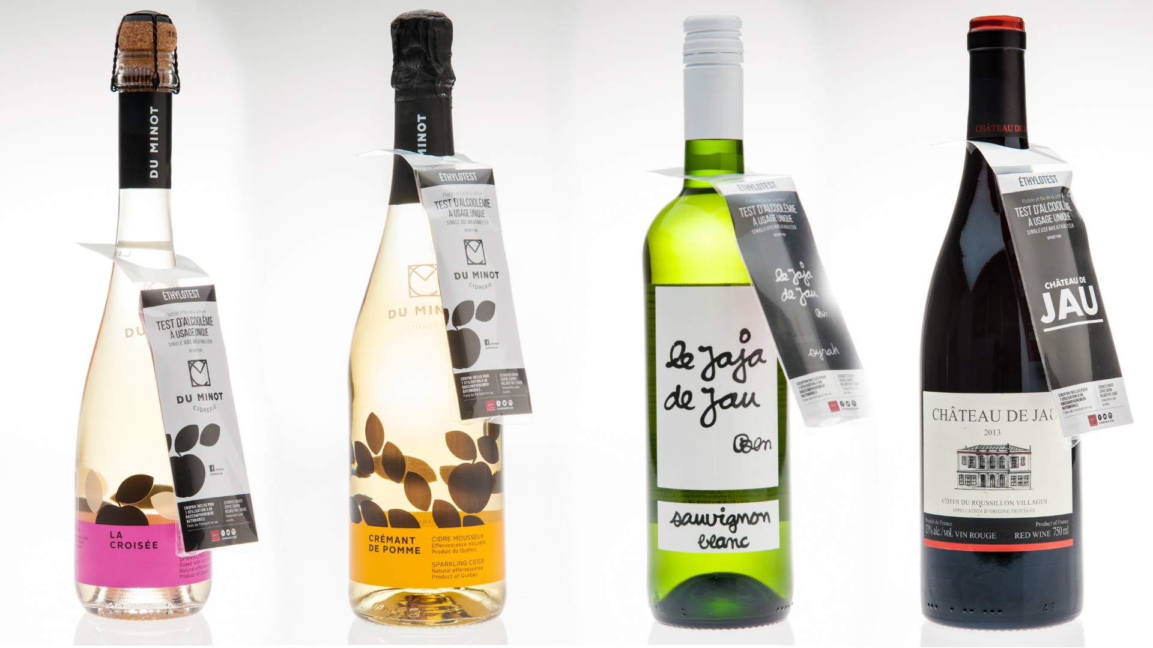
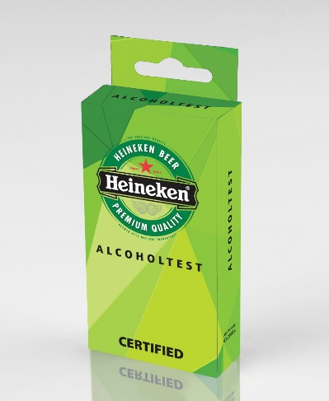
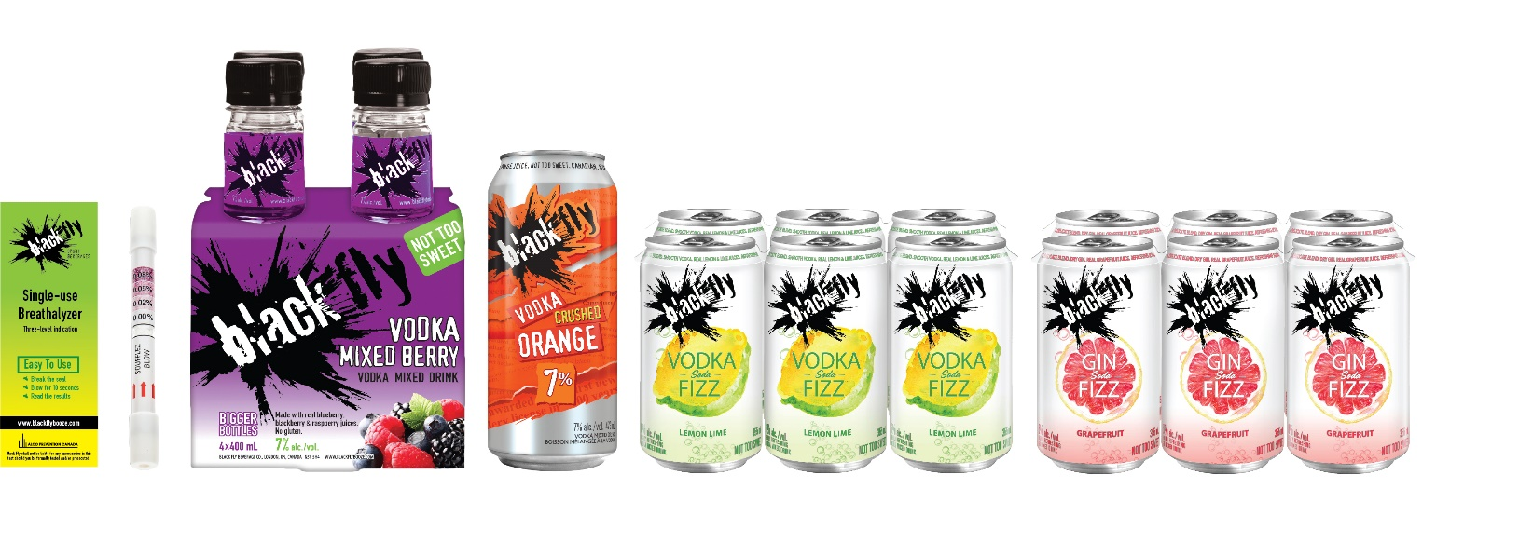

Slide 15
Contact Info
Alco Prevention Canada
www.alcoprevention.com
Product number APC 2008 breathalyzer
APC 2009 Alco tee
Stephane Maurais
514-838-0775
smaurais@alcoprevention.com
ASI 30166

